Slide 1

Image Enhancement
Dr. S.Kandar
Assistant Professor
Department of Information Technology
IIEST, Shibpur

Slide 2
Introduction
Objective- to process an image so that the results is more suitable than original image for a specific applications
Enhancement approaches are two types:
Spatial domain based approach
Direct manipulation of pixel value
Frequency domain based approach
Transform image into Fourier/DCT domain and then apply the method
Note: each image enhancement technique that is suitable for one application may not be suitable for other applications.

Slide 3
Introduction
Enhancement of quality => increasing the dominance of some features ( at the cost of suppression of some features).
The enhancement techniques are divided into three categories:
Contrast intensification
Noise cleaning or smoothing
Edge sharpening

Slide 4
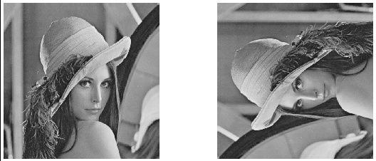
Transpose of image
B(i,j) = A(j,i)
A
B

Slide 5
Flip image vertically
B(i,M-1-j) = A(i,j)
A
B

Slide 6
Cropping of image
B(k,l) = A(n₁+k,n₂+l); k= 0 to N₁-1 and l=0 to N₂-1
A
B

Slide 7
Principle Objective of Enhancement
the result will be more suitable than the original image for a specific application.
The suitableness is up to each application.
A method which is quite useful for enhancing an image may not necessarily be the best approach for enhancing another image.

Slide 8
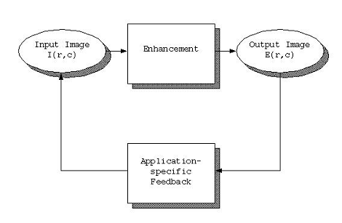
Application feedback process

Slide 9
Domain of enhancement
Spatial Domain : (image plane)
The term spatial domain refers to aggregate of pixels composing an image
Techniques are based on direct manipulation of pixels in an image
Frequency Domain :
Techniques are based on modifying the Fourier transform of an image
There are some enhancement techniques based on various combinations of methods from these two categories.

Slide 10
Image Enhancement in the Spatial Domain
In this case image enhancement is performed in the Spatial domain resulting in images in the Spatial domain.
We can written as
where f(x, y) is an original image, g(x, y) is an output and
T[ ] is a function defined in the area around (x, y)
Note: T[ ] may have one input as a pixel value at (x, y) only
or
multiple inputs as pixels in neighbors of (x, y) depending in
each function.
Ex. Contrast enhancement uses a pixel value at (x, y) only
for an input while smoothing filter use several pixels around
(x, y) as inputs.

Slide 11
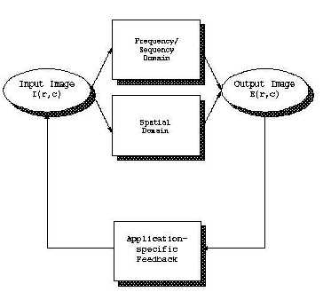
Image enhancement domain

Slide 12
Types of Image Enhancement in the Spatial Domain
- Single pixel methods
- Gray level transformations
Example
- Historgram equalization
- Contrast stretching
- Arithmetic/logic operations
Examples
- Image subtraction
- Image averaging
- Multiple pixel methods
Examples
Spatial filtering
- Smoothing filters
- Sharpening filters

Slide 13
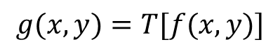
Spatial Domain Methods
The value of a pixel at location (x,y) in the enhanced image is the result of performing some operation on the pixels in the neighborhood of (x,y) in the input image.
T
operator
neighborhood
around f(x,y)
g(x,y)
input image f
$$g(x,y)=T[f(x,y)]$$
output image g
For computational reasons the neighborhood is usually square but it can be any shape.

Slide 14
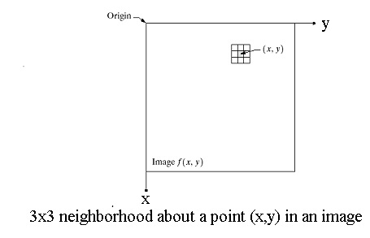
Image enhancement
There is no general theory of image enhancement; viewer is the ultimate judge
The spatial domain process is expressed by
g(x,y) = T[f(x,y)] where f is the input image and g is the processed image. T is an operator on f, defined on some neighbors of (x,y)
Neighbors can be square or rectangle in shape centered at (x,y)

Slide 15
Shape of neighborhood

Slide 16
Enhancement techniques
Point operations : Each pixel is modified by an equation that is not dependent on other pixel values
Mask operations : Each pixel is modified according to the values in a small neighborhood (subimage)
Global operations : All pixel values in the image are taken into consideration
Spatial domain processing methods include all three types, but frequency domain operations, are global operations

Slide 17
Point Processing
utilize a “function” g(l) (l = 0,…,255) to generate a new image B from a given image A via:
B(i,j) = g(A(i, j)); i = 0,…,N-1; j = 0,…,M-1
g(l) operates on each image pixel or each image point independently.
In general the resulting image g(A(i; j)) may not be an image matrix, i.e., it may be the case that g(A(i,j)) does not belong to {0,…,255} for some (i,j).
Thus to make sure we obtain an image B that is an image matrix.
The histograms h_{A}(l) and h_{B}(l) will play important roles.

Slide 18
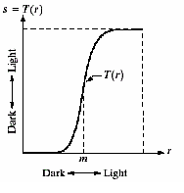
Contrast Enhancement (point processing)
Produce higher contrast than the original by
darkening the levels below m in the original image
brightening the levels above m in the original image

Slide 19
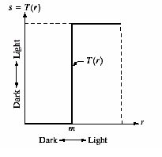
Threshloding (point processing)
Produce a two-level (binary) image
Before transformation pixel value is r and after transformation value is s

Slide 20
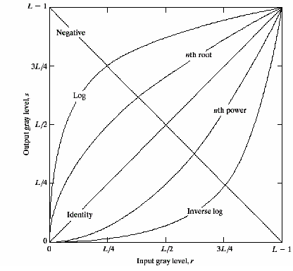
Basic gray level transformation
Linear function: Negative and identity transformations
Logarithm function: Log and inverse-log transformation
Power-law function: n^{th} power and n^{th} root transformation functions

Slide 21
Identity point function
Let g(l) = l (l = 0,…,255).
B(i,j) = g(A(i,j)); i = 0,…,N-1; j = 0,…,M-1
= A(i,j)
In this case g(A(i; j)) belongs to {0,…,255} so no further processing is necessary to ensure B is an image matrix.
Note also that B = A and hence h_{A}(l)=h_{B}(l).

Slide 22
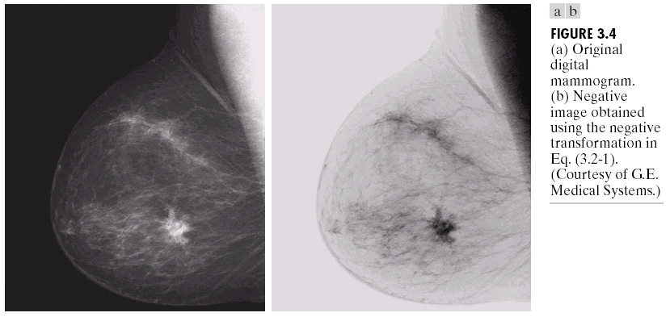
Image Negative
L-1
Original
digital
mammogram
White
Output intensity
Negative
digital
mammogram
Black
0
L-1
Black
Input intensity
White
L = the number of gray levels
(Images from Rafael C. Gonzalez and Richard E.
Wood, Digital Image Processing, 2nd Edition.

Slide 23
Digital Negative
Let g(l) = 255-l (l = 0,…,255)
B(i,j) = g(A(i,j)); i = 0,…,N-1; j = 0,…, M-1
= 255 - A(i,j)
Suitable for enhancing white or gray detail embedded in dark regions of an image, especially when the black area dominant in size.

Slide 24
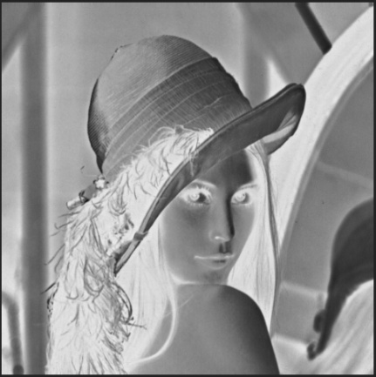
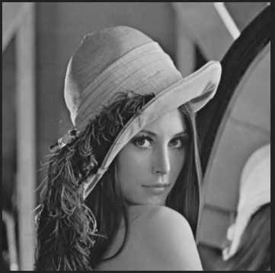
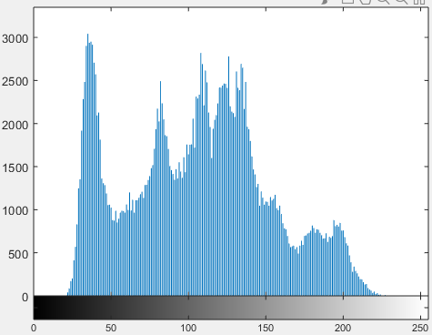
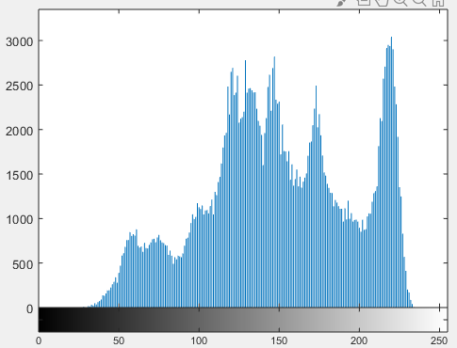
Image negation (by bit complement)
g(I) = bit complement (I)
Negative image histogram
Original image histogram

Slide 25
Image negation (why not by maximum gray value present)
S=M-r , M is the maximum gray value present.
Task:
Which is better?
How to retrieve the original image?

Slide 26
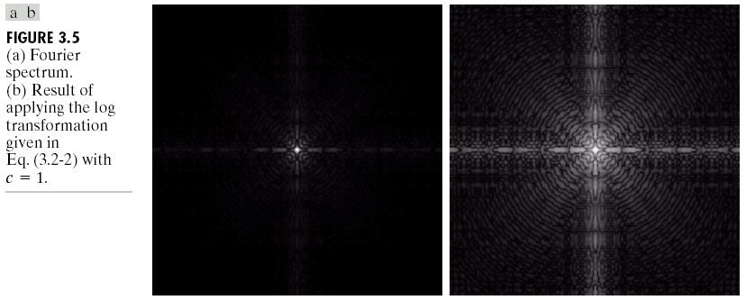
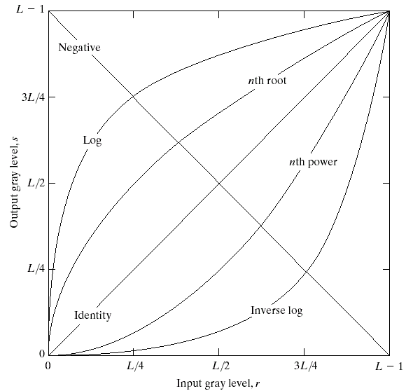
Log Transformations
Application
s is the output pixel value after transformation , c is a scaling constant to adjust the contrast of the image r is the input pixel value
Fourier
spectrum
Log Tr. of
Fourier
spectrum
(Images from Rafael C. Gonzalez and Richard E.
Wood, Digital Image Processing, 2nd Edition.

Slide 27
useful for images with dark or dim regions
commonly seen in medical imaging, where details in X-ray or MRI images can be challenging to discern without proper enhancement.
Noise Reduction: can help reduce the impact of noise in low-intensity regions of an image. Noise tends to have a higher impact on dark regions, and by compressing these regions, the noise's visibility is decreased.

Slide 28
Log Transformations
s = c log (1+r) c is a constant and r >=0
Log curve maps a narrow range of low gray-level values in the input image into a wider range of output levels.
Used to expand the values of dark pixels in an image while compressing the higher level values.

Slide 29
Log Transformations
Compresses the dynamic range of images with large variations in pixel values.
Example of image with dynamic range: Fourier spectrum image.
It can have intensity range from 0 to 10⁶ or higher.
We can’t see the significant degree of detail as it will be lost in the display.

Slide 30
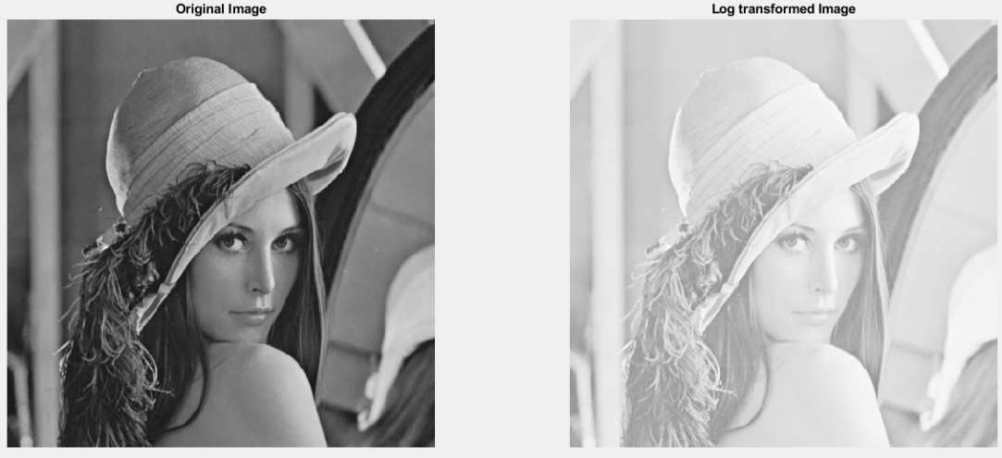
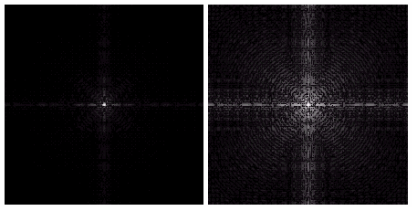
Example of Logarithm Image

Slide 31
Inverse Logarithm Transformations
Do opposite to the Log Transformations
Used to expand the values of high pixels in an image while compressing the darker-level values.

Slide 32
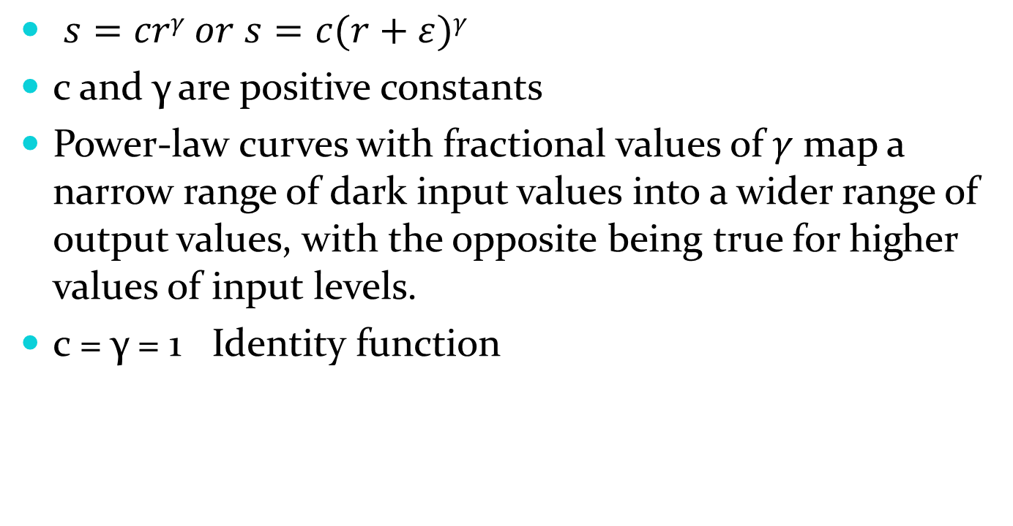
Power-Law Transformations
Also known as gamma correction

Slide 33
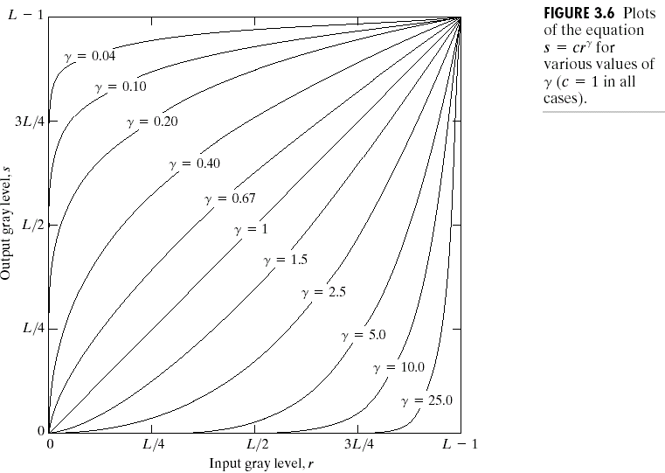
Power function with c=1

Slide 34
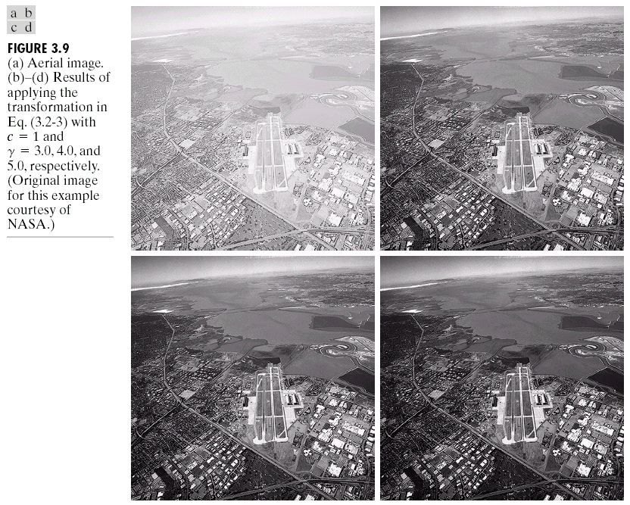
Output of power function
Gamma=3.0
Org
Gamma=4.0
Gamma=5.0

Slide 35
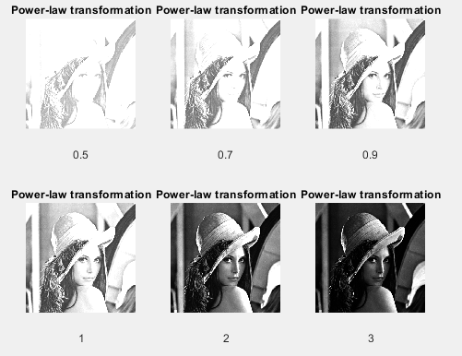

Slide 36
Piecewise-Linear transformations
Piecewise-Linear Transformation is complementary approach to methods previously discussed
Advantage:
The form of piecewise functions can be arbitrarily complex
Disadvantage:
Their specification requires considerably more user input

Slide 37
Piecewise-Linear Transformation Functions
r=T(s)
r = alpha₁ * l
+ alpha₂ * (l-l₁) + alpha₁ * l₁
+ alpha₃ * (l-l₂) + alpha₁ * l₁ + alpha₂ * (l₂ - l₁)
Alpha > 1 range stretching
< 1 compression
= identity
0 to l₁
0 to l₁ – l₂
0 to L-1– l₂

Slide 38
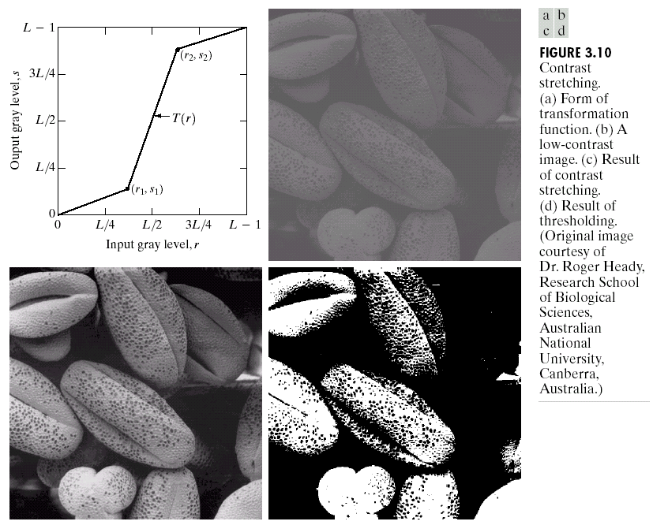
Contrast Stretching
increase the dynamic range of the gray levels in the image
a low-contrast image : result from poor illumination, lack of dynamic range in the imaging sensor, or even wrong setting of a lens aperture of image acquisition.

Slide 39
How to know where the contrast is enhanced ?
Notice the slope of T(r)
if Slope > 1 → Contrast increases
if Slope < 1 → Contrast decrease
if Slope = 1 → no change
Δs
Δr
Smaller Δr yields wider Δs
= increasing Contrast
(Images from Rafael C. Gonzalez and Richard E.
Wood, Digital Image Processing, 2nd Edition.

Slide 40
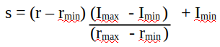
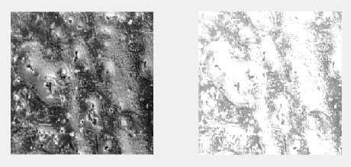
(10, 60) → (120, 180)

Slide 41
Contrast Stretching
The location (r1,s1) and (r2,s2) control the transformation.
If (r1=s1) and (r2=s2), then identical function
If (r1=r2) and (s1=0 and s2=L-1) thresholding function
(r2,s2)
(r1,s1)

Slide 42
Contrast Stretching
In general r1<=r2 and s1<=s2
Single valued and monotonically increasing function
Preserves the order of grey-level and reduces the chances of artifact
Normally, r1 =r_{min} , s1=0 and r2=r_{max} , s2=L-1
(r2,s2)
(r1,s1)

Slide 43
Homework
I has pixel range (t_{i}) from 0 to 7
If contrast stretching is applied as below then what will be the range of the pixel values in the output image
Slope=0.1
Slope=0.5
Slope=0.2
t1 =2
t2=5

Slide 44
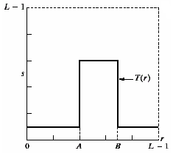
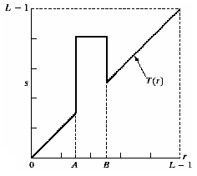
Gray-level slicing
Highlighting a specific range of gray levels in an image
Display a high value of all gray levels in the range of interest
transformation highlights range [A,B] of gray level and reduces all others to a constant level
transformation highlights range [A,B] but preserves all other levels

Slide 45
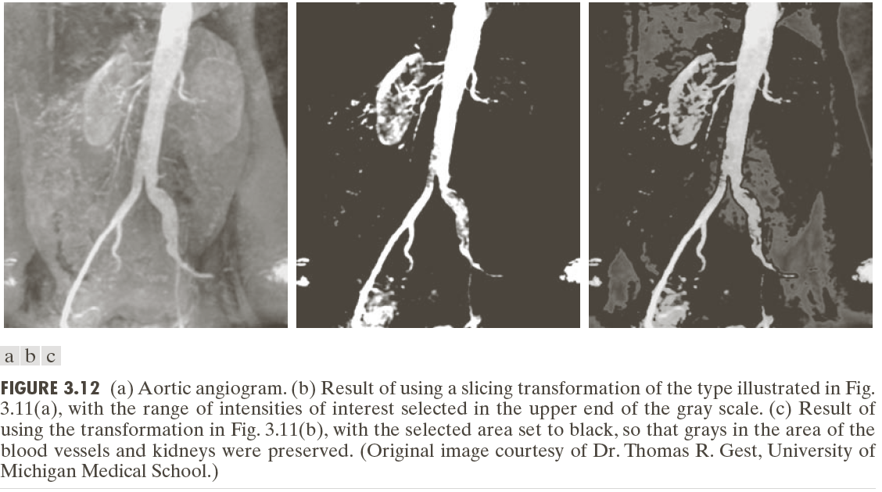
Example of gray level slicing
Input Output

Slide 46
Homework
I =
230
25 | 110 | 180 | 210
45 | 150 | 205 | 230
94 | 200 | 240 | 210
120 | 80 | 250 | 200
180
What will be the output image?
0
90
130
255

Slide 47
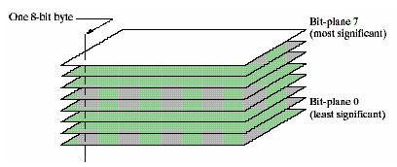
Bit-plane slicing
Highlighting the contribution made to total image appearance by specific bits
Suppose each pixel is represented by 8 bits
Higher-order bits contain the majority of the visually significant data
Useful for analyzing the relative importance played by each bit of the image

Slide 48
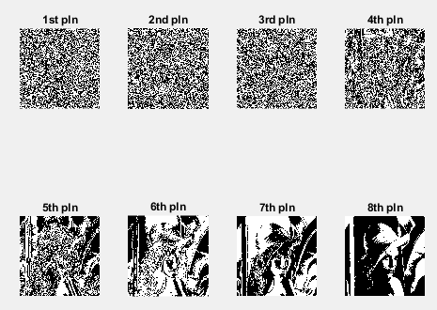

Slide 49
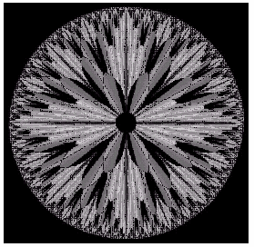
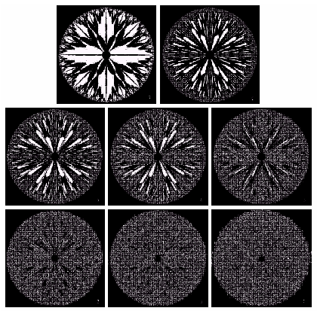
Bit-plane slicing
7
6
Original image
5
4
3
0
2
1
0

Slide 50
Homework
7 | 6 | 5
4 | 3 | 2
1 | 1 | 0
I=
Find the images with only LSB is complemented and only MSB is complemented.

Slide 51
Simple Image Statistics- Histogram
Let S be a set and define #S as the cardinality of this set
The histogram h_{A}(l) (l=0,…,255) of the image A is defined as:
h_{A}(l) = #{(i,j) | A(i,j)=l, i=0,…,N-1; j=0,…,M-1}
For(i=0;i<255;i++)
H[i]=0;
for(i=0;i<N;i++)
for(j=0;j<M;j++)
H[A(i,j)]++;

Slide 52
Histogram
Histogram = Graph of population frequencies
Grades of the course 178 xxx

Slide 53
Histogram
A h_{A}(l)

Slide 54
Histogram
A h_{A}(l)

Slide 55
Histogram
A h_{A}(l)

Slide 56
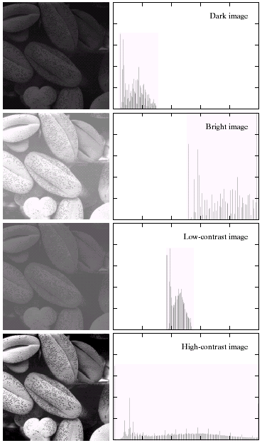
Histogram of an Image
Histogram of an image = graph of no. of pixels vs intensities
Dark image has
histogram on the left
จำนวน pixel
Bright image has
histogram on the right
จำนวน pixel
(Images from Rafael C. Gonzalez and Richard E.
Wood, Digital Image Processing, 2nd Edition.

Slide 57
Histogram of an Image (cont.)
low contrast image
has narrow histogram
high contrast image
has wide histogram
(Images from Rafael C. Gonzalez and Richard E.
Wood, Digital Image Processing, 2nd Edition.

Slide 58
Histogram Processing
Basic for numerous spatial domain processing techniques.
Used effectively for image enhancement
Information inherent in histograms also is useful in image compression and segmentation.

Slide 59
Histogram Processing
= intensity transformation based on histogram
information to yield desired histogram
-Histogram Stretching
- Histogram equalization
To make histogram distributed uniformly
- Histogram matching
To make histogram as the desire

Slide 60
Normalized Histogram
dividing each of histogram at gray level r_{k} by the total number of pixels, n
P(r_{k}) = n_{k} /n
P(r_{k}) gives an estimate of the probability of occurrence of gray level r_{k}
The sum of all components of a normalized histogram is equal to 1
Make (min, max) to (0,255)

Slide 61
Histogram Stretching
Aim is to spread the histogram to cover the entire dynamic range.
increase contrast.
The mapping function is
(s_{max} and s_{min} are maximum and minimum of pixel values in the stretched histogram and r_{max} and r_{min} are that of original image)
Transformation is
If the target histogram covers entire gray level then

Slide 62
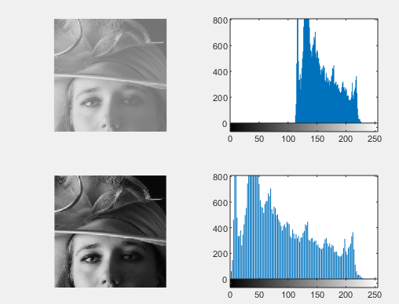

Slide 63
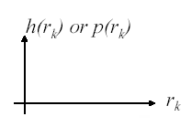
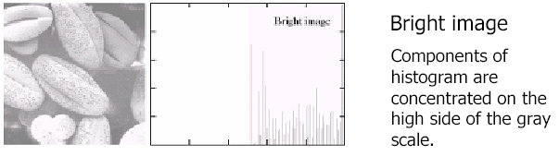
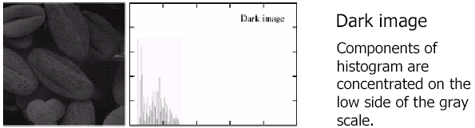
Example

Slide 64
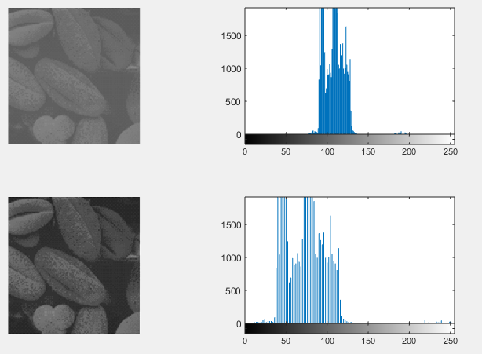
Max: 198
Min: 71
Max: 255
Min: 0

Slide 65
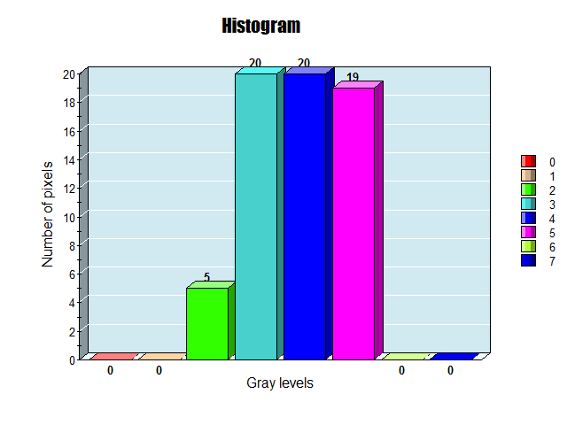
HOMEWORK
Perform histogram stretching of the image
Gray level | No of pixels
0 | 0
1 | 0
2 | 5
3 | 20
4 | 20
5 | 19
6 | 0
7 | 0
When there will be no effect of histogram stretching?

Slide 66
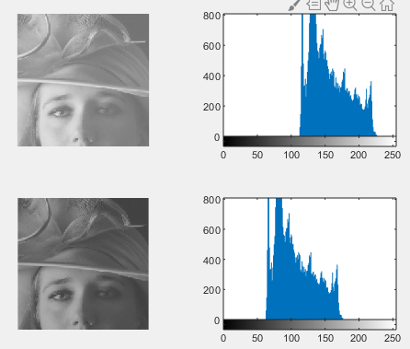
Histogram Sliding
S= r+offset
Offset=-50

Slide 67
Histogram Equalization
Contrast stretching means histogram stretching
the low-contrast image’s histogram is narrow and centered toward the middle of the gray scale,
distribute the histogram to a wider range the quality of the image will be improved.
adjust the probability density function of the original histogram of the image so that the probability spread equally.

Slide 68
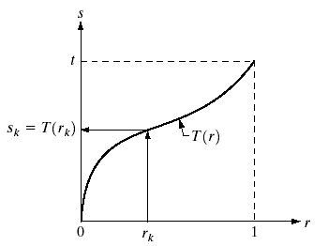
Monotonically Increasing Function
T()= Function that is only increasing or constant
r: gray levels of the image to be enhanced
r can be normalized to the interval [0,1] as r/(L-1)
Properties of Histogram
processing function
Must satisfy
1. Single valued monotonically increasing
Function in 0≤ r ≤ 1
2.
Produce a level s for every pixel value r.
T(r ₂) ≥ T(r ₁) if r₂> r₁

Slide 69
Probability Density Function
Histogram is analogous to Probability Density Function
(PDF) which represent density of population
Let s and r be Random variables with PDF p_{s}(s) and p_{r}(r ) respectively
and relation between s and r is
r ∈ [0, 1]
r in the image can be viewed as random variable in [0, 1]
s is the transformation of r
and r is normalized
If p_{r}(r) and T(r) are known and T(r) is continuous and differentiable over the range
We get

Slide 70
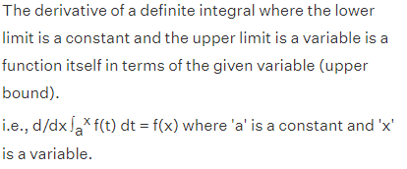
Histogram Equalization
Let
Dummy variable of integration
Now s is a cumulative distribution function
We get
0≤ s ≤ 1

Slide 71
Histogram Equalization
Formula in the previous slide is for a continuous PDF
For Histogram of Digital Image, we use
n_{j} = the number of pixels with intensity r_{j}
N = the number of total pixels
Note: for discrete transformation, a discrete equivalent of uniform probability density function (uniform histogram) can not be found. But the histogram will spread over the span.

Slide 72
Discrete transformation function
The probability of occurrence of gray level in an image is approximated by p_{r}(r_{k}) = n_{k}/N , k= 0 to L-1
The discrete version of transformation s_{k} = T(r_{k}) = p₀ + p₁ + p₂ + … + p_{k} = (n₀ + n₁ + n₂ + … + n_{k})/N
Thus, an output image is obtained by mapping each pixel with level r_{k} in the input image into a corresponding pixel with level s_{k} in the output image

Slide 73
Histogram Equalization Example
Intensity | # pixels
0 | 20
1 | 5
2 | 25
3 | 10
4 | 15
5 | 5
6 | 10
7 | 10
Total | 100
Accumulative Sum of P_{r}
20/100 = 0.2
(20+5)/100 = 0.25
(20+5+25)/100 = 0.5
(20+5+25+10)/100 = 0.6
(20+5+25+10+15)/100 = 0.75
(20+5+25+10+15+5)/100 = 0.8
(20+5+25+10+15+5+10)/100 = 0.9
(20+5+25+10+15+5+10+10)/100 = 1.0
1.0

Slide 74
Histogram Equalization Example (cont.)
Intensity (r) | No. of Pixels (n_{j}) | Acc Sum of P_{r} | Output value | Quantized Output (s)
0 | 20 | 0.2 | 0.2x7 = 1.4 | 1
1 | 5 | 0.25 | 0.25*7 = 1.75 | 2
2 | 25 | 0.5 | 0.5*7 = 3.5 | 3
3 | 10 | 0.6 | 0.6*7 = 4.2 | 4
4 | 15 | 0.75 | 0.75*7 = 5.25 | 5
5 | 5 | 0.8 | 0.8*7 = 5.6 | 6
6 | 10 | 0.9 | 0.9*7 = 6.3 | 6
7 | 10 | 1.0 | 1.0x7 = 7 | 7
Total | 100

Slide 75
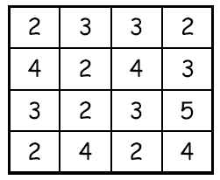
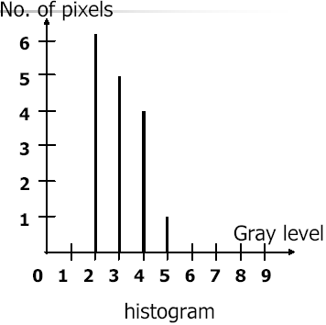
Example

Slide 76
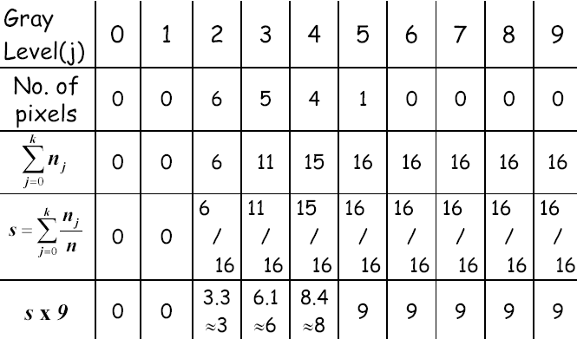
Example (Contd.)

Slide 77
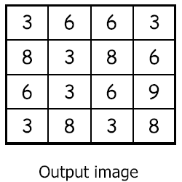
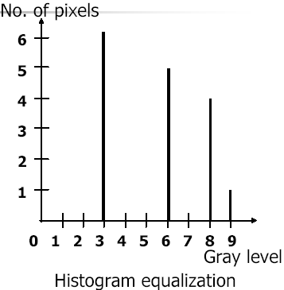
Example (Contd.)

Slide 78
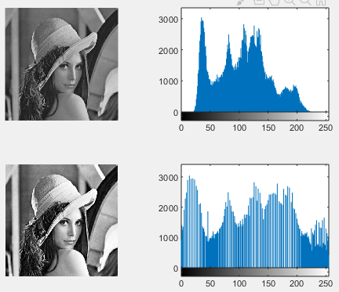

Slide 79
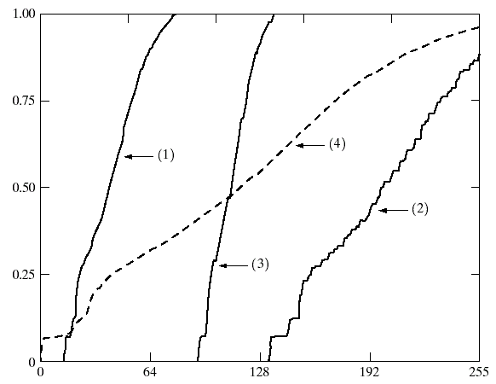
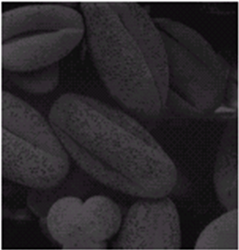
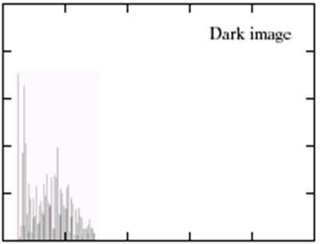


Histogram Equalization
(Images from Rafael C. Gonzalez and Richard E.
Wood, Digital Image Processing, 2nd Edition.

Slide 80


Histogram Equalization (cont.)
(Images from Rafael C. Gonzalez and Richard E.
Wood, Digital Image Processing, 2nd Edition.

Slide 81
Histogram Equalization (cont.)
(Images from Rafael C. Gonzalez and Richard E.
Wood, Digital Image Processing, 2nd Edition.

Slide 82
Histogram Equalization (cont.)
(Images from Rafael C. Gonzalez and Richard E.
Wood, Digital Image Processing, 2nd Edition.

Slide 83


Histogram Equalization (cont.)
Original
image
After histogram equalization, the image become a low contrast image
Then what will be the fate of a complete black image?
(Images from Rafael C. Gonzalez and Richard E.
Wood, Digital Image Processing, 2nd Edition.

Slide 84
Note
Histogram equalization distributes the gray level to reach the maximum gray level (white) because the cumulative distribution function equals 1 when 0<= r <=L-1
the discrete transformation function can’t guarantee the one to one mapping relationship

Slide 85
Homework
Perform histogram equalization of the following image (having gray level 0-7 )
0 | 0 | 0 | 7
0 | 0 | 7 | 7
0 | 0 | 7 | 7
0 | 7 | 7 | 7
i)
iii)
4 | 4 | 4 | 4
4 | 4 | 4 | 4
4 | 4 | 4 | 4
4 | 4 | 4 | 4
ii)
0 | 0 | 0 | 0
0 | 0 | 0 | 0
0 | 0 | 0 | 0
0 | 0 | 0 | 0

Slide 86
Histogram Matching (Specification)
Histogram equalization can generates only one type of output image.
With Histogram Specification, we can specify the shape of the histogram that we wish the output image to have.
It doesn’t have to be a uniform histogram

Slide 87
Note
Histogram specification is a trial-and error process
There are no rules for specifying histograms, and one must resort to analysis on a case-by-case basis for any given enhancement task.

Slide 88
Histogram Equalization
I
mapping
Target Histogram
Histogram Equalization
Histogram specified image

Slide 89
Histogram Matching : Algorithm
To transform image histogram to be a desired histogram
Concept : from Histogram equalization, we have
We get p_{s}(s) = 1
We want an output image to have PDF p_{z}(z)
Apply histogram equalization to p_{z}(z), we get
We get p_{v}(v) = 1
Since p_{s}(s) = p_{v}(v) = 1 therefore s and v are equivalent
Therefore, we can transform r to z by
r
T( )
s
G⁻¹( )
z

Slide 90
n_{j} = the number of pixels with intensity r_{j}
N = the number of total pixels
Note: All mapping from r to s and from s to z are table lookup between a given pixel value

Slide 91

Histogram Matching : Algorithm (cont.)
s = T(r)
v = G(z)
2
1
3
z = G⁻¹(v)
4
(Images from Rafael C. Gonzalez and Richard E.
Wood, Digital Image Processing, 2nd Edition.

Slide 92
Histogram Matching Example
Input image
histogram
Example
Desired Histogram
Intensity ( r ) | # pixels
0 | 20
1 | 5
2 | 25
3 | 10
4 | 15
5 | 5
6 | 10
7 | 10
Total | 100
Intensity ( z ) | # pixels
0 | 5
1 | 10
2 | 15
3 | 20
4 | 20
5 | 15
6 | 10
7 | 5
Total | 100
Original
data
User define

Slide 93
Histogram Matching Example (cont.)
1. Apply Histogram Equalization to both tables
r | (n_{j}) | ΣP_{r} | s
0 | 20 | 0.2 | 1
1 | 5 | 0.25 | 2
2 | 25 | 0.5 | 3
3 | 10 | 0.6 | 4
4 | 15 | 0.75 | 5
5 | 5 | 0.8 | 6
6 | 10 | 0.9 | 6
7 | 10 | 1.0 | 7
z | (n_{j}) | ΣP_{z} | v
0 | 5 | 0.05 | 0
1 | 10 | 0.15 | 1
2 | 15 | 0.3 | 2
3 | 20 | 0.5 | 4
4 | 20 | 0.7 | 5
5 | 15 | 0.85 | 6
6 | 10 | 0.95 | 7
7 | 5 | 1.0 | 7
s_{k} = T(r_{k})
v_{k} = G(z_{k})

Slide 94
Histogram Matching Example (cont.)
2. Get a map
Actual Output
Histogram
We get
r → s
v → z
s → v
Intensity ( r ) | # pixels
0 | 20
1 | 5
2 | 25
3 | 10
4 | 15
5 | 5
6 | 10
7 | 10
Total | 100
r | z
0 | 1
1 | 2
2 | 2
3 | 3
4 | 4
5 | 5
6 | 5
7 | 6
z | # Pixels
0 | 0
1 | 20
2 | 30
3 | 10
4 | 15
5 | 15
6 | 10
7 | 0
r | s
0 | 1
1 | 2
2 | 3
3 | 4
4 | 5
5 | 6
6 | 6
7 | 7
v | z
0 | 0
1 | 1
2 | 2
4 | 3
5 | 4
6 | 5
7 | 6
7 | 7
s_{k} = T(r_{k})
z_{k} = G⁻¹(v_{k})

Slide 95

Source: https://towardsdatascience.com/histogram-matching-ee3a67b4cbc1

Slide 96

Histogram Matching Example (cont.)
Desired histogram
Transfer function
Actual histogram
(Images from Rafael C. Gonzalez and Richard E.
Wood, Digital Image Processing, 2nd Edition.

Slide 97
Histogram Matching Example (cont.)
After
histogram
equalization
After
histogram
matching
Original
image

Slide 98
Note
Histogram processing methods are global processing, in the sense that pixels are modified by a transformation function based on the gray-level content of an entire image.
Sometimes, we may need to enhance details over small areas in an image, which is called a local enhancement.

Slide 99
Perform histogram specification of the 8×8 image.
1 | 2 | 5 | 5 | 5 | 6 | 7 | 7
2 | 1 | 4 | 4 | 5 | 2 | 4 | 4
4 | 4 | 2 | 0 | 5 | 6 | 4 | 4
4 | 4 | 0 | 2 | 5 | 5 | 2 | 5
2 | 2 | 0 | 0 | 5 | 5 | 5 | 5
6 | 2 | 0 | 5 | 5 | 2 | 0 | 0
1 | 1 | 3 | 5 | 5 | 3 | 0 | 1
6 | 1 | 1 | 4 | 4 | 1 | 1 | 1
Grey levels (r _{k}) | 0 | 1 | 2 | 3 | 4 | 5 | 6 | 7
Number of pixels (p_{k} ) | 8 | 10 | 10 | 2 | 12 | 16 | 4 | 2

Slide 100
Homework
Perform histogram specification of the 8×8 image.
Target
Grey levels (r _{k}) | 0 | 1 | 2 | 3 | 4 | 5 | 6 | 7
Number of pixels (p_{k} ) | 0 | 0 | 0 | 0 | 20 | 20 | 16 | 8
Answer
Grey levels (r _{k}) | 0 | 1 | 2 | 3 | 4 | 5 | 6 | 7
Map to | 4 | 4 | 5 | 5 | 6 | 6 | 7 | 7

Slide 101
Local enhancement
Global method is computationally intensive.
The concepts can be used, but in local sense. That is consider a square or rectangular neighborhood and move the center of this area from pixel to pixel.
At each location, the histogram of the points in the neighborhood is computed and either histogram equalization or histogram specification transformation function is obtained.
Another approach used to reduce computation is to utilize non-overlapping regions, but it usually produces an undesirable checkerboard effect.

Slide 102


Local enhancement
Basically, the original image consists of many small squares inside the larger dark ones.
However, the small squares were too close in gray level to the larger ones, and their sizes were too small to influence global histogram equalization significantly.
So, when we use the local enhancement technique, it reveals the small areas.

Slide 103

Local Enhancement : Histogram Statistic for Image Enhancement
We can use statistic parameters such as Mean, Variance of Local area
for image enhancement
Image of tungsten filament taken using
An electron microscope
In the lower right corner, there is a
filament in the background which is
very dark and we want this to be
brighter.
We cannot increase the brightness of
the whole image since the white
filament will be too bright.
(Images from Rafael C. Gonzalez and Richard E.
Wood, Digital Image Processing, 2nd Edition.

Slide 104

Local Enhancement
Example: Local enhancement for this task
Global SD
global mean
Local mean
Local standard deviation
Specified constant
Local Variance
image
Multiplication
factor
Original image
(Images from Rafael C. Gonzalez and Richard E.
Wood, Digital Image Processing, 2nd Edition.

Slide 105

Local Enhancement
Output image
(Images from Rafael C. Gonzalez and Richard E.
Wood, Digital Image Processing, 2nd Edition.

Slide 106
Enhancement using Arithmetic/Logic Operations
Arithmetic/Logic operations perform on pixel by pixel basis between two or more images.
except NOT operation which perform only on a single image.
Logical AND or OR operations are used for masking (Region of interest)

Slide 107

Example of AND Operation

Slide 108

Example of OR Operation

Slide 109
Image subtraction
g(x,y) = f(x,y) – h(x,y)
enhancement of the differences between the images.

Slide 110

Arithmetic Operation: Subtraction
Application: Error measurement
Error
image
(Images from Rafael C. Gonzalez and Richard E.
Wood, Digital Image Processing, 2nd Edition.

Slide 111

Arithmetic Operation: Subtraction (cont.)
Application: Mask mode radiography in angiography work
(Images from Rafael C. Gonzalez and Richard E.
Wood, Digital Image Processing, 2nd Edition.

Slide 112
Note
We may have to adjust the gray-scale of the subtracted image to be [0, 255] (if 8-bit is used)
first, find the minimum gray value of the subtracted image
second, find the maximum gray value of the subtracted image
set the minimum value to be zero and the maximum to be 255
while the rest are adjusted according to the interval [0, 255], by timing each value with 255/max
Subtraction is also used in segmentation of moving pictures to track the changes
after subtract the sequenced images, what is left should be the moving elements in the image, plus noise

Slide 113
Image Averaging
consider a noisy image g(x,y) formed by the addition of noise η(x,y) to an original image f(x,y)
g(x,y) = f(x,y) + η(x,y)
if noise has zero mean and be uncorrelated at (x,y) [works on the assumption that the noise in your image is truly random.]
then it can be shown that if
image formed by averaging K different noisy images

Slide 114

Image averaging

Slide 115

Image averaging

Slide 116



Slide 117


Slide 118
Spatial Filtering
A common application of spatial filtering is image smoothing using an averaging filter, or averaging mask, or kernel.
average
g(x,y)
neighborhood
around f(x,y)
input image f
output image g
Each point in the smoothed image, g(x,y) is obtained from the average pixel value in a neighborhood of f(x,y) in the input image.

Slide 119
Basics of Spatial Filtering
Sometime we need to manipulate values obtained from
neighboring pixels
Example: How can we compute an average value of pixels
in a 3x3 region center at a pixel z?
Pixel z
2
4
1
2
6
2
9
2
3
4
4
4
7
2
9
7
6
7
5
2
3
6
1
5
7
4
2
5
1
2
2
5
2
3
2
8
Image

Slide 120
Basics of Spatial Filtering (cont.)
Step 1. Selected only needed pixels
Pixel z
2
4
1
2
6
2
…
9
2
3
4
4
4
3
4
4
7
2
9
7
6
7
…
9
7
6
…
5
2
3
6
1
5
3
6
1
7
4
2
5
1
2
…
2
5
2
3
2
8

Slide 121
Basics of Spatial Filtering (cont.)
Step 2. Multiply every pixel by 1/9 and then sum up the values
…
3
4
4
…
9
7
6
…
3
6
1
…
X
1
1
1
Mask or
Window or
Template
1
1
1
1
1
1

Slide 122
Basics of Spatial Filtering (cont.)
Question: How to compute the 3x3 average values at
every pixels?
Solution: Imagine that we have
a 3x3 window that can be placed
everywhere on the image
2
4
1
2
6
2
9
2
3
4
4
4
7
2
9
7
6
7
5
2
3
6
1
5
7
4
2
5
1
2
Masking Window

Slide 123
Basics of Spatial Filtering (cont.)
Step 1: Move the window to the first location where we want to
compute the average value and then select only pixels
inside the window.
2
4
1
2
6
2
2
4
1
Step 2: Compute
the average value
9
2
3
4
4
4
9
2
3
7
2
9
7
6
7
7
2
9
5
2
3
6
1
5
Sub image p
7
4
2
5
1
2
Step 3: Place the
result at the pixel
in the output image
Original image
4.3
Step 4: Move the
window to the next
location and go to Step 2
Output image

Slide 124
Basics of Spatial Filtering (cont.)
The mask operation at each point is performed by:
1. Move the reference point (center) of mask to the
location to be computed
2. Compute sum of products between mask coefficients
and pixels in subimage under the mask.
…
Mask frame
w(1,1)
w(2,1)
w(3,1)
p(1,1)
p(2,1)
p(3,1)
…
…
w(1,2)
w(2,2)
w(3,2)
p(2,1)
p(2,2)
p(3,2)
p(1,3)
p(2,3)
p(3,3)
w(3,1)
w(3,2)
w(3,3)
…
Mask coefficients
Subimage
The reference point
of the mask

Slide 125
Basics of Spatial Filtering (cont.)
The spatial filtering on the whole image is given by:
Move the mask over the image at each location.
Compute sum of products between the mask coefficeints and pixels inside subimage under the mask.
Store the results at the corresponding pixels of the
output image.
Move the mask to the next location and go to step 2 until all pixel locations have been used.

Slide 126
Examples of Spatial Filtering Masks
Examples of the masks
Sobel operators
3x3 moving average filter
-1
0
1
-1
-2
-1
1
1
1
-2
0
2
0
0
0
1
1
1
-1
0
1
1
2
1
1
1
1
3x3 sharpening filter
-1
-1
-1
-1
8
-1
-1
-1
-1

Slide 127
Convolutions
Computationally, spatial filtering is implemented by convolution.
For 3x3 neighborhood the smoothing by averaging would correspond to convolving the image with the following filter, or mask.
This filter is convolved with the image by placing it over a 3x3 portion of the image, multiplying the overlaying pixel values and adding them all up to find the value that replaces the original central pixel value.
1/9
1/9
1/9
1/9
1/9
1/9
1/9
1/9
1/9

Slide 128


Slide 129
.1 | .1 | .1
.1 | .1 | .1
.1 | .1 | .1
Filter
3 | 2 | 1 | 2 | 2
4 | 2 | 5 | 3 | 3
8 | 6 | 3 | 1 | 1
4 | 7 | 2 | 1 | 6
6 | 5 | 3 | 2 | 8
- | - | - | - | -
- | 3.4 |  |  | -
- |  |  |  | -
-
x.1 | x.1 | x.1
x.1 | x.1 | x.1
x.1 | x.1 | x.1
Input image
Filtered image

Slide 130
.1 | .1 | .1
.1 | .1 | .1
.1 | .1 | .1
Filter
3 | 2 | 1 | 2 | 2
4 | 2 | 5 | 3 | 3
8 | 6 | 3 | 1 | 1
4 | 7 | 2 | 1 | 6
6 | 5 | 3 | 2 | 8
- | - | - | - | -
- | 3.4 | 2.5 |  | -
- |  |  |  | -
-
x.1 | x.1 | x.1
x.1 | x.1 | x.1
x.1 | x.1 | x.1
Input image
Filtered image

Slide 131
.1 | .1 | .1
.1 | .1 | .1
.1 | .1 | .1
Filter
3 | 2 | 1 | 2 | 2
4 | 2 | 5 | 3 | 3
8 | 6 | 3 | 1 | 1
4 | 7 | 2 | 1 | 6
6 | 5 | 3 | 2 | 8
- | - | - | - | -
- | 3.4 | 2.5 | 2.1 | -
- |  |  |  | -
-
x.1 | x.1 | x.1
x.1 | x.1 | x.1
x.1 | x.1 | x.1
Input image
Filtered image

Slide 132
.1 | .1 | .1
.1 | .1 | .1
.1 | .1 | .1
Filter
3 | 2 | 1 | 2 | 2
4 | 2 | 5 | 3 | 3
8 | 6 | 3 | 1 | 1
4 | 7 | 2 | 1 | 6
6 | 5 | 3 | 2 | 8
- | - | - | - | -
- | 3.4 | 2.5 | 2.1 | -
- | 4.1 |  |  | -
-
x.1 | x.1 | x.1
x.1 | x.1 | x.1
x.1 | x.1 | x.1
Input image
Filtered image

Slide 133
.1 | .1 | .1
.1 | .1 | .1
.1 | .1 | .1
Filter
3 | 2 | 1 | 2 | 2
4 | 2 | 5 | 3 | 3
8 | 6 | 3 | 1 | 1
4 | 7 | 2 | 1 | 6
6 | 5 | 3 | 2 | 8
- | - | - | - | -
- | 3.4 | 2.5 | 2.1 | -
- | 4.1 | 3.0 |  | -
-
x.1 | x.1 | x.1
x.1 | x.1 | x.1
x.1 | x.1 | x.1
Input image
Filtered image

Slide 134
.1 | .1 | .1
.1 | .1 | .1
.1 | .1 | .1
Filter
3 | 2 | 1 | 2 | 2
4 | 2 | 5 | 3 | 3
8 | 6 | 3 | 1 | 1
4 | 7 | 2 | 1 | 6
6 | 5 | 3 | 2 | 8
- | - | - | - | -
- | 3.4 | 2.5 | 2.1 | -
- | 4.1 | 3.0 | 2.5 | -
-
x.1 | x.1 | x.1
x.1 | x.1 | x.1
x.1 | x.1 | x.1
Input image
Filtered image

Slide 135
.1 | .1 | .1
.1 | .1 | .1
.1 | .1 | .1
Filter
3 | 2 | 1 | 2 | 2
4 | 2 | 5 | 3 | 3
8 | 6 | 3 | 1 | 1
4 | 7 | 2 | 1 | 6
6 | 5 | 3 | 2 | 8
- | - | - | - | -
- | 3.4 | 2.5 | 2.1 | -
- | 4.1 | 3.0 | 2.5 | -
- | 4.4
x.1 | x.1 | x.1
x.1 | x.1 | x.1
x.1 | x.1 | x.1
Input image
Filtered image

Slide 136
.1 | .1 | .1
.1 | .1 | .1
.1 | .1 | .1
Filter
3 | 2 | 1 | 2 | 2
4 | 2 | 5 | 3 | 3
8 | 6 | 3 | 1 | 1
4 | 7 | 2 | 1 | 6
6 | 5 | 3 | 2 | 8
- | - | - | - | -
- | 3.4 | 2.5 | 2.1 | -
- | 4.1 | 3.0 | 2.5 | -
- | 4.4 | 3.0
x.1 | x.1 | x.1
x.1 | x.1 | x.1
x.1 | x.1 | x.1
Input image
Filtered image

Slide 137
.1 | .1 | .1
.1 | .1 | .1
.1 | .1 | .1
Filter
3 | 2 | 1 | 2 | 2
4 | 2 | 5 | 3 | 3
8 | 6 | 3 | 1 | 1
4 | 7 | 2 | 1 | 6
6 | 5 | 3 | 2 | 8
- | - | - | - | -
- | 3.4 | 2.5 | 2.1 | -
- | 4.1 | 3.0 | 2.5 | -
- | 4.4 | 3.0 | 2.7
x.1 | x.1 | x.1
x.1 | x.1 | x.1
x.1 | x.1 | x.1
Input image
Filtered image

Slide 138
The mask is moved across the image until every pixel has been covered.
We convolve the image with the mask.
.1 | .1 | .1
.1 | .1 | .1
.1 | .1 | .1
Filter
3 | 2 | 1 | 2 | 2
4 | 2 | 5 | 3 | 3
8 | 6 | 3 | 1 | 1
4 | 7 | 2 | 1 | 6
6 | 5 | 3 | 2 | 8
- | - | - | - | -
- | 3.4 | 2.5 | 2.1 | -
- | 4.1 | 3.0 | 2.5 | -
- | 4.4 | 3.0 | 2.7 | -
- | - | - | - | -
Input image
Filtered image

Slide 139
The mask is moved across the image until every pixel has been covered.
We convolve the image with the mask.
.1 | .1 | .1
.1 | .1 | .1
.1 | .1 | .1
Filter
3 | 2 | 1 | 2 | 2
4 | 2 | 5 | 3 | 3
8 | 6 | 3 | 1 | 1
4 | 7 | 2 | 1 | 6
6 | 5 | 3 | 2 | 8
- | - | - | - | -
- | 3.4 | 2.5 | 2.1 | -
- | 4.1 | 3.0 | 2.5 | -
- | 4.4 | 3.0 | 2.7 | -
- | - | - | - | -
Input image
Filtered image

Slide 140
Size of padding
For a gray scale (M x N) image and (m x n) filter/kernel, the dimensions of the image resulting from a convolution operation is (M – m + 1) x (N – n + 1).
Sol-- Padding Input Images
adding layers of zeros to input images so as to avoid the problems mentioned above.
p = number of layers of zeros added to the border of the image,
(M x N) image becomes (M + 2p) x (N + 2p)
Applying convolution-operation (with (m x n) filter) outputs (M + 2p – m + 1) x (N + 2p – n + 1) images.
p=(m-1)/2 for row p=(n-1)/2 for column

Slide 141
Zero
padding
Modified pixel
m X n
Original Image

Slide 142
Spatial Filter
Linear Filter
(Example: Mean Filter)
Non-linear filter
(Example: Median filter, Maximum and minimum filter)

Slide 143
Smoothing Spatial Filters
used for blurring and for noise reduction
output is simply the average of the pixels contained in the neighborhood of the filter mask.
called averaging filters or lowpass filters.
replacing the value of every pixel in an image by the average of the gray levels in the neighborhood will reduce the “sharp” transitions in gray levels.

Slide 144

Smoothing Spatial Filters
Noise is sharp transition in the image
But edges are also sharp transition
sharp transitions
random noise in the image
edges of objects in the image
thus, smoothing can reduce noises (desirable) and blur the edges (undesirable).

Slide 145

3x3 Smoothing Linear Filters
Giving more importance to some pixels at the expense of others
[1/3, 1/3, 1/3]
1/3
1/3
1/3
Attempts to reduce blurring.

Slide 146
Mean filter
Arithmetic mean filter
Geometric mean filter
m,n : Size of rectangular window centred at x,y
S : Set of co-ordinates in the rectangular subwindow
achieves smoothing comparable to the arithmetic mean filter, but it tends to lose less image detail in the process.

Slide 147
Weighted mean filter
Adaptive weighted mean filter
adjusts the weights of neighboring pixels in a filter kernel based on the local characteristics of the image
computes the weights dynamically for each pixel in the image based on its neighborhood.
allows to preserve edges and fine details better in an image.

Slide 149
Weighted average filter
weighting the center point the highest
reducing the value of the coefficients as a function of increasing distance from the origin.
an attempt to reduce blurring in the smoothing process.

Slide 150

General form : smoothing mask
filter of size mxn (m and n odd)
a=(m-1)/2 b=(n-1)/2

Slide 151


Slide 152
Order-Statistic Filters
Original image
subimage
Statistic parameters
Mean, Median, Mode,
Min, Max, Etc.
Moving
window
Output image

Slide 153


Smoothing Linear Filter : Moving Average
Application : noise reduction
and image smoothing
Disadvantage: lose sharp details
(Images from Rafael C. Gonzalez and Richard E.
Wood, Digital Image Processing, 2nd Edition.

Slide 154
If 3X3 average filter applied twice?
Is two times 3X3 is same as once 5X5?

Slide 155

Smoothing Linear Filter (cont.)
(Images from Rafael C. Gonzalez and Richard E.
Wood, Digital Image Processing, 2nd Edition.

Slide 156
Smoothing is useful when we want to eliminate fine detail, particularly if that detail is an artifact of the image and not part of the inherent information.
The larger the smoothing neighborhood, the more blurred the result becomes.
Smoothing can be useful in eliminating "salt and pepper" noise.
White and black dots on images

Slide 157
Gaussian filter for smoothing

Slide 158
Order-Statistics Filters (Nonlinear Filters)
the response is based on ordering (ranking) the pixels contained in the image area encompassed by the filter.
example
median filter: R = median{z_{k} | k= 0,1,…, n x n}
max filter : R = max{z_{k} | k= 0,1,…, n x n}
min filter : R = min{z_{k} | k= 0,1,…, n x n}
note: n x n is the size of the mask

Slide 159
Median Filtering
the central pixel value in a neighborhood is replaced by the median value of those pixels.
The median of a list of numbers is the value such that half the numbers are less than this value and the other half are greater.
For example, the list 1 1 1 1 3 3 3 3 5 has median 3.
median
g(x,y)
neighborhood
around f(x,y)
input image f
output image g

Slide 160
Median Filters
replaces the value of a pixel by the median of the gray levels in the neighborhood of that pixel
quite popular because for certain types of random noise (impulse noise) they provide excellent noise-reduction capabilities.
Less blurring than linear smoothing filters of similar size.
forces the points with distinct gray levels to be more like their neighbors.
particularly good at removing "salt and pepper" noise while preserving edge structure.

Slide 161

Noise
Mean vs median filtering

Slide 162

Order-Statistic Filters: Median Filter
(Images from Rafael C. Gonzalez and Richard E.
Wood, Digital Image Processing, 2nd Edition.

Slide 163
Sharpening Spatial Filters
to highlight fine detail in an image or
to enhance detail that has been blurred, either in error or as a natural effect of a particular method of image acquisition.

Slide 164
Sharpening
The opposite of smoothing is sharpening.
The basic idea is to identify those pixels that are substantially different from their neighbors, so that the edges and fine detail stand out.
The usual way to sharpen is to multiply the value of the centre pixel by the number of pixels in the neighborhood (4 in the smallest neighborhood), and then to subtract the sum of the values of the other pixels.
Thus the filter looks like
0
-1
0
-1
4
-1
This is just one of a number of sharpening filters one can use
0
-1
0

Slide 165
Blurring vs. Sharpening
blurring can be done in spatial domain by pixel averaging in a neighbors.
since averaging is analogous to integration.
the sharpening is accomplished by spatial differentiation.

Slide 166
Derivative operator
are used to analyze how pixel values change across an image.
It calculates the rate of change of pixel intensities.
crucial for tasks like edge detection, image enhancement, and feature extraction.
two primary types of derivative operators used in digital image processing: first-order derivatives and second-order derivatives.
thus, image differentiation
enhances edges and other discontinuities (noise)

Slide 167

The strength of the response of a derivative operator is proportional to the degree of discontinuity of the image at the point at which the operator is applied.
derivative operator measures the rate of change of pixel intensities.
sudden change or discontinuity in pixel values, indicates the presence of an edge or some significant feature in the image.
in smooth regions where pixel values change gradually, the rate of change (and derivative response) is low.
Derivatives capture these discontinuities by measuring the steepness of intensity changes.

Slide 168
First-order derivative
a basic definition of the first-order derivative of a one-dimensional function f(x) is the difference

Slide 169
Properties of first order derivatives
Must be zero in flat segments (areas of constant gray-level values)
Must be nonzero at the onset of a gray-level step or ramp
Must be nonzero along ramp

Slide 170

Second-order derivative
similarly, we define the second-order derivative of a one-dimensional function f(x) is the difference.

Slide 171
Properties of second order derivatives
Must be zero in flat segments (areas of constant gray-level values)
Must be nonzero at the onset and end of a gray gray-level step or ramp
Must be zero along ramp of constant slope

Slide 172

Example

Slide 173

Source: Digital Image Processing FOURTH EDITION Rafael C. Gonzalez • Richard E. Woods

Slide 174
first and second order derivates
The response of 2nd order derivative much stronger than 1st order at an isolated noise point.
Example: (10, 200, 10) ∆f(x) = 200-10 =190
∆² f(x) = 380
Second order derivative is much aggressive than first order derivative in enhancing sharp changes.

Slide 175

First and Second-order derivative of f(x,y)
when we consider an image function of two variables, f(x,y), at which time we will dealing with partial derivatives along the two spatial axes.

Slide 176

Discrete Form of Laplacian

Slide 177
Laplacian Sharpening : How it works
Intensity profile
Edge
p(x)
1st derivative
2nd derivative

Slide 178
Laplacian Sharpening : How it works (cont.)
p(x)
Laplacian sharpening results in larger intensity discontinuity
near the edge.

Slide 179


Laplacian Sharpening : How it works (cont.)
Before sharpening
p(x)
After sharpening

Slide 180
Laplacian Masks
Used for estimating image Laplacian
-1
-1
-1
0
-1
0
The center of the mask
is positive
-1
8
-1
-1
4
-1
-1
-1
-1
0
-1
0
or
1
1
1
0
1
0
The center of the mask
is negative
1
-8
1
1
-4
1
1
1
1
0
1
0
Application: Enhance edge, line, point
Disadvantage: Enhance noise

Slide 181

Image sharpening: Laplacian
easily by adding the original and Laplacian image.
be careful with the Laplacian filter used

Slide 182


Imaging sharpening with Laplacian
image of the North pole of the moon
Laplacian-filtered image with
Laplacian image scaled for display purposes
image enhanced by addition with original image
b
a
c
d

Slide 183

Laplacian Sharpening Example
p
(Images from Rafael C. Gonzalez and Richard E.
Wood, Digital Image Processing, 2nd Edition.

Slide 184

Mask of Laplacian + addition
to simply the computation, we can create a mask which do both operations, Laplacian Filter and Addition the original image.

Slide 185
Unsharp Masking and High-Boost Filtering
-1
-1
-1
0
-1
0
-1
A+8
-1
-1
A+4
-1
-1
-1
-1
0
-1
0
Equation:
The center of the mask is negative
The center of the mask is positive

Slide 186




Example of Laplacian
Composite Laplacian mask
Original Image
Result of Filtering
Result of Filtering

Slide 187
Unsharp masking
is a sharpening technique used in image processing to enhance the edges and fine details within an image.
does not involve creating a mask or sharpness filter directly.
Instead, it works by subtracting a blurred version of the original image from the original image, emphasizing the edges and fine details.
Sharpened Image=Original Image+(Original Image−Blurred Image)
Used to improve the visual quality of images, especially when the images have been softened during processes like resizing or compression.

Slide 188

Unsharp Masking and High-Boost Filtering (cont.)
(Images from Rafael C. Gonzalez and Richard E.
Wood, Digital Image Processing, 2nd Edition.

Slide 189
Unsharp masking

Slide 190
Gradient Operator
first derivatives are implemented using the magnitude of the gradient. [2D column vector]

Slide 191

Gradient Operator

Slide 192


Gradient Mask
simplest approximation, 2x2
f(x+1) – f(x)
f(y+1) – f(y)

Slide 193
Gradient Mask
Roberts cross-gradient operators, 2x2

Slide 194

Gradient Mask
Z4-Z1+Z5-Z2
+Z5-Z2+Z6-Z3
+Z7-Z4+Z8-Z5
+Z8-Z5+Z9-Z6
Sobel operators, 3x3

Slide 195
M(x,y) ≈ |( Z7+2Z8+Z9)-(Z1+2Z2+Z3)|
+ |(Z3+2Z6+Z9)-(Z1+2Z4+Z7)|

Slide 196



First Order Partial Derivative:
Sobel operators
-1
0
1
-1
-2
-1
-2
0
2
0
0
0
-1
0
1
1
2
1
P

Slide 197

First Order Partial Derivative: Image Gradient
Gradient magnitude
A gradient image emphasizes edges
(Images from Rafael C. Gonzalez and Richard E.
Wood, Digital Image Processing, 2nd Edition.

Slide 198

First Order Partial Derivative: Image Gradient
P

Slide 199


Image Enhancement in the Spatial Domain : Mix things up !
B
D
smooth
A
+
-
B: Laplacian
C: A+B
D: Sobel
E: Smooth of D by 5x5 average filter
Sharpening
C
(Images from Rafael C. Gonzalez and Richard E.
Wood, Digital Image Processing, 2nd Edition.
E

Slide 200
Image Enhancement in the Spatial Domain : Mix things up !
Power
Law Tr.
G
C
E
Σ
F
A
Multiplication
(Images from Rafael C. Gonzalez and Richard E.
Wood, Digital Image Processing, 2nd Edition.
H

Slide 201

Note
the summation of coefficients in all masks equals 0, indicating that they would give a response of 0 in an area of constant gray level.
Original Image Sobel gradient

Slide 202
Gaussian smoothing
Sometimes we want to emphasize the fact that the closest pixels are the ones most influencing the result in an area transform process.
Thus we use a smoothing filter that places more weight on the central pixel, and which lessens the weight the further one moves from the centre.
When the distribution of weights follows the shape of a bell curve, the filter is called a Gaussian filter.
0.00 0.01 0.02 0.01 0.00 0.01 0.06 0.10 0.06 0.01 0.02 0.10 0.16 0.10 0.02 0.01 0.06 0.10 0.06 0.01 0.00 0.01 0.02 0.01 0.00
A 5x5 mask approximating a Gaussian

